Slide 1
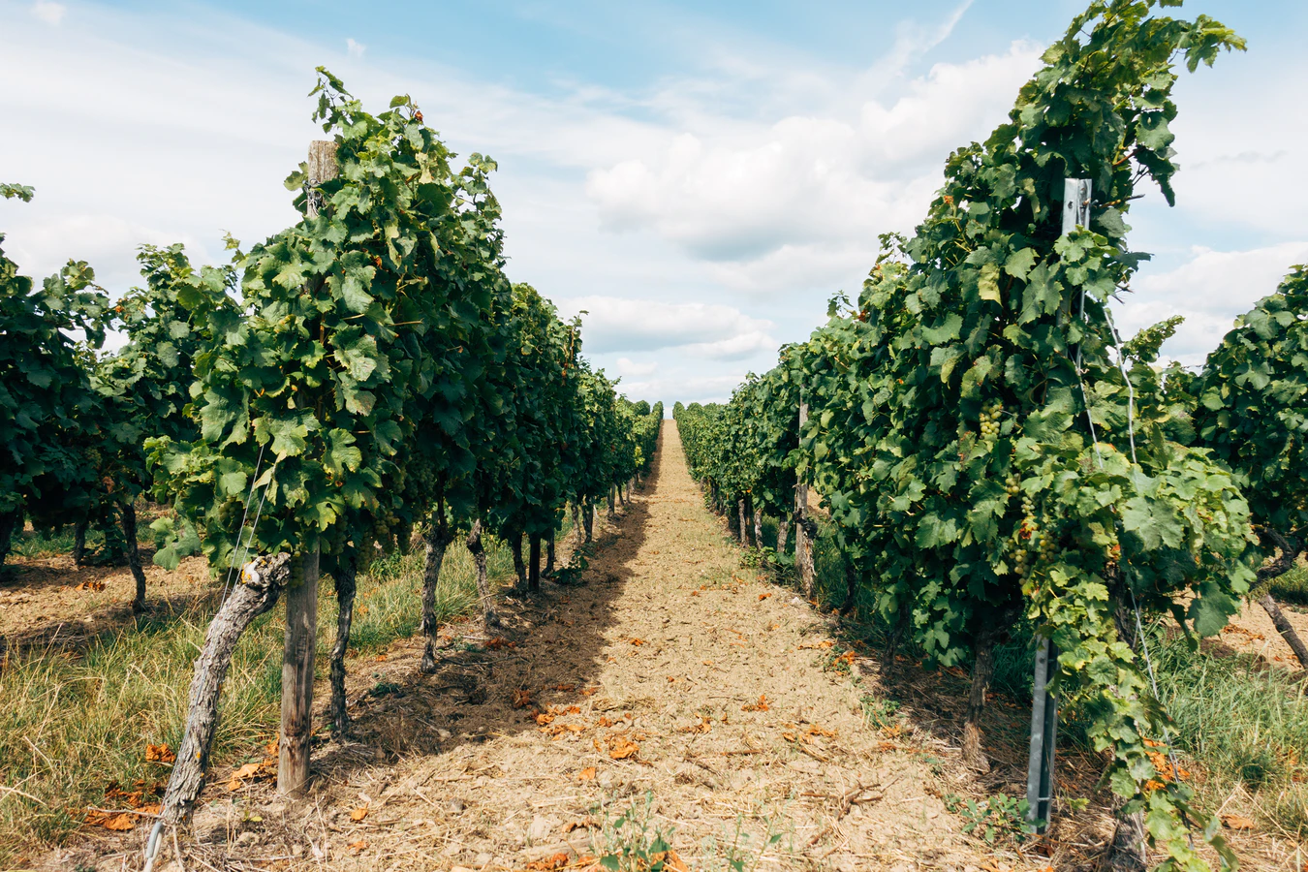
Pact for Skills in the Agri-food Ecosystem
FIELDS 5th Project Meeting
Monday 30 May 2022

Slide 2
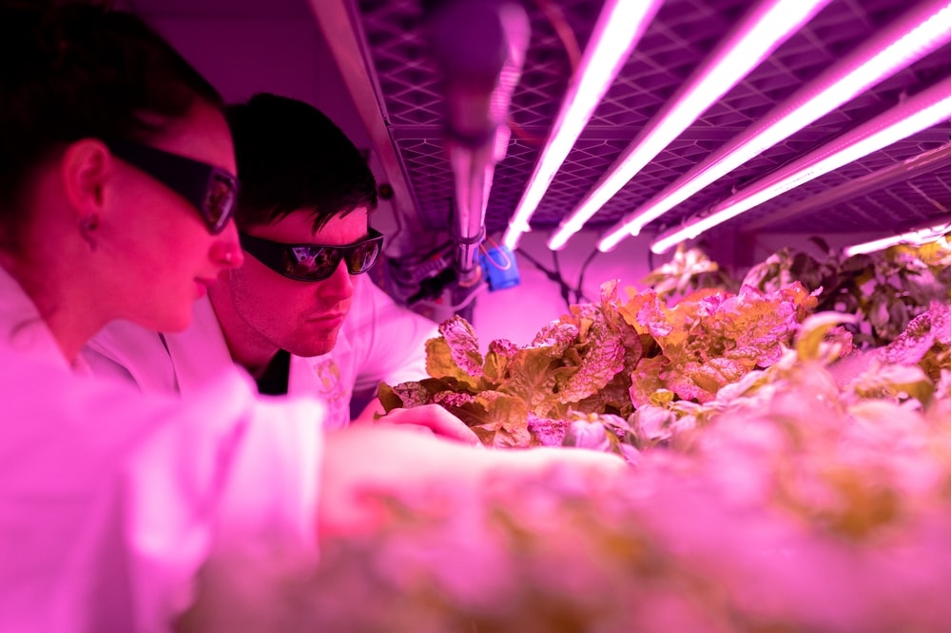
The Agri-food Ecosystem
10 million farms and 22.000 agri-food cooperatives ;
20 million professionals
47 % of the total EU land area
289.000 food processing companies
4.5 million professionals
15.1 % of the total manufacturing
Notes:
The agriculture and food industry is the largest producing and manufacturing sector in Europe. More than 10 million farms and 22.000 agri-food cooperatives in the EU create jobs for a
workforce of 20 million employees, especially in rural areas, and more than 294.000 food processing companies provide jobs for 4.8 million people. Overall, the agri-food ecosystem is
by far the biggest employment sector in Europe; it has a significant impact on rural and urban communities, as an aggregated ecosystem that includes more than 99% of small and medium-sized enterprises (SMEs).
According to Eurostat, farms covered 191.9 million hectares of land in the EU in 2016, equivalent to 47 % of the total land area. More than four fifths (81.6 %) of the farm area in the EU was used for agricultural production in 2016, a total of 156.7 million hectares.
The vast majority of the EU’s F&B processors were micro or small enterprises that employed fewer than 50 persons. By contrast, large enterprises — employing 250 or more persons — accounted for 55.8 % of the total value added in food processing, and for an even higher share (67.0 %) of the added value in beverage processing.

Slide 3
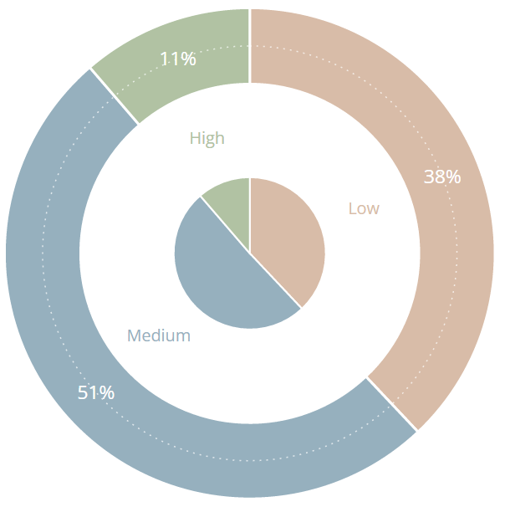
Education Level
CHART I: Employment in agriculture, forestry
& fishing sectors in EU in 2020 by education level
Notes:
“Higher levels of undeclared work in the agriculture sector are a result of intense cost pressures from the food processing industry and food retailers to whom agricultural producers supply most of their output”, as stated in the report “Tackling undeclared work in the agricultural sector” from 2018. The share of workers employed by officially registered temporary work agencies (according to Eurostat) was at 2.1 % in the EU-27 in 2019.

Slide 4
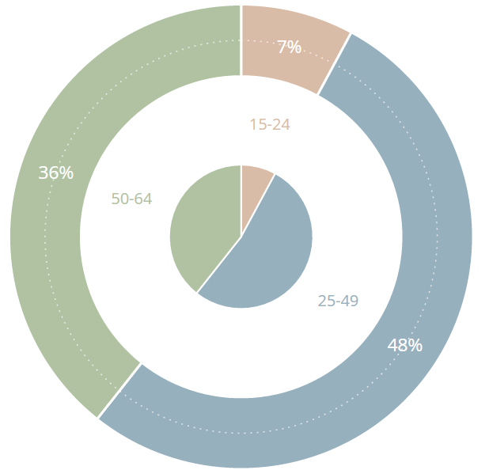
Age Groups
CHART II: Employment in agriculture, forestry
& fishing sectors in EU in 2020 by age groups
Notes:
27% of all employment in the agriculture, forestry and fishing sector is dependent self-employment (2018).
32% of employees in agriculture do not have written contracts of employment (2018).
9% of employees in the agricultural sector in the EU received envelope wages, compared with 5% of all employees in employment in the EU overall (2007).

Slide 5
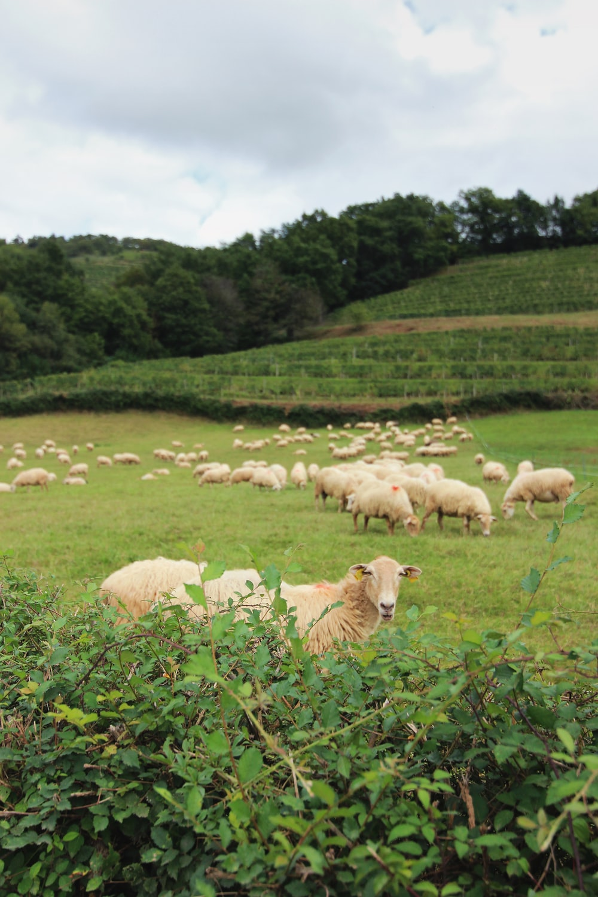
Workforce Typology
Family labour;
Non-family labour;
Regular full-time or part-time workers;
Non-regular full-time or part-time workers;
Cross-border or posted or seasonal workers
Intra-EU or Non-EU
Notes:
Family farming remains the dominant type of farming in the EU. In 2016, nine out of ten agricultural workers in the EU were either the farm owner or one of his/her family members.
Since 2011, both intra- and extra-EU migrant agricultural workers have increased rapidly, while the overall labour outflow from the EU agricultural sector was almost entirely due to movement of MS national workers. Between 2011 and 2017, more than 1.3 million national agricultural workers left the sector. This outflow was partially compensated by inflows of both intra- and extra-EU migrant workers.
According to Eurostat, the number of farm mangers decreased among all age groups, with the largest decreases in relative terms among younger ones: down 7.3 % among those farmer managers aged 25-34 years and down 41.0 % among those farm managers younger than 25 years.
Types of Seasonal Workers
Coming from other Member States;
EU Seasonal Workers
They have the right to take up employment in another Member State, including seasonal work.
Coming from third countries;
Non-EU Seasonal Workers
They usually need to apply for a visa, work permit or a residence permit to stay and work in a Member State.
There are about 10 million dependent farmworkers in the EU, out of which about 4 million are cross border or migrant workers and 6 million national residents.

Slide 6
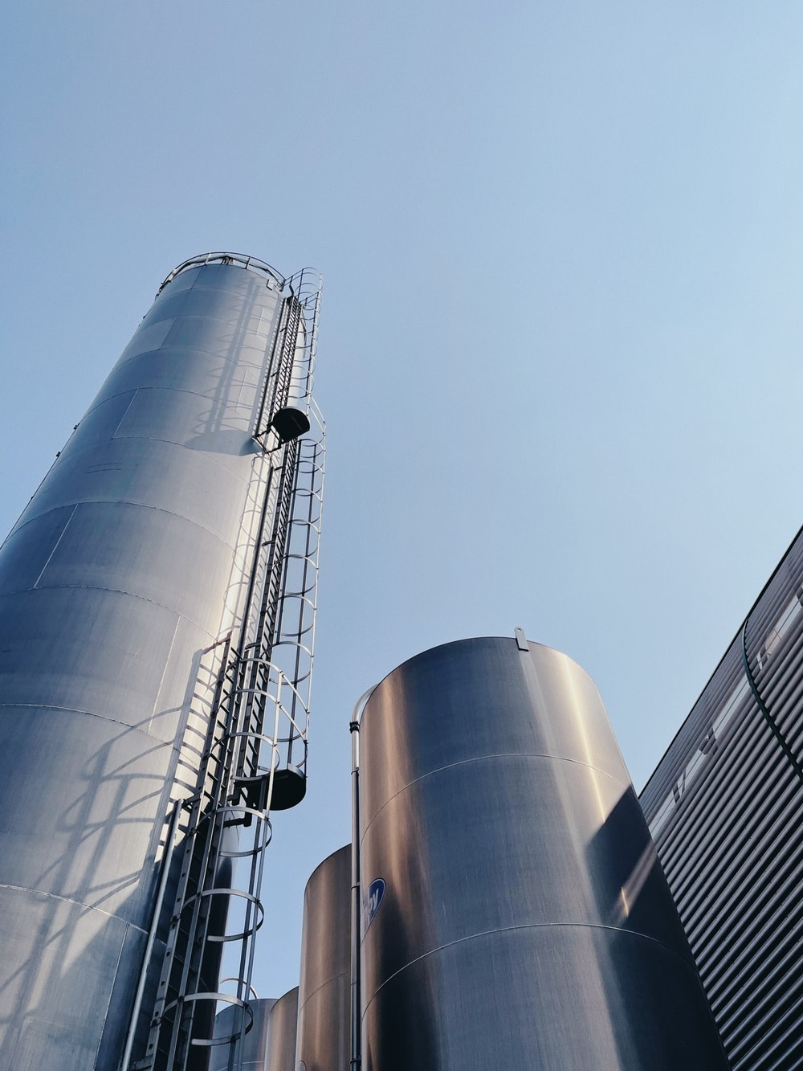
Transversal Challenges
Globalization;
Climate change;
Urbanisation trends;
Changing consumer demands;
Sector attractiveness;
Technological disruptions;
Third-country competition;
The Covid-19 pandemic;
Notes:
According to Eurostat, there were about 4.1 million fewer farms in the EU in 2016 than in 2005, a decrease of 28 %. The vast majority of the decrease in farm numbers concerned farms less than 5 hectares in size; there were 3.5 million fewer farms in this category during the period under consideration. The only category of farms for which an increase in farm numbers was observed was for farms with at least 100 hectares.

Slide 7
The Proposition
DG GROW
DG AGRI
DG EMPL
PACT FOR SKILLS: AGRI-FOOD
FOOD INDUSTRIES
AGRICULTURE
Notes:
According to Eurostat, there were about 4.1 million fewer farms in the EU in 2016 than in 2005, a decrease of 28 %. The vast majority of the decrease in farm numbers concerned farms less than 5 hectares in size; there were 3.5 million fewer farms in this category during the period under consideration. The only category of farms for which an increase in farm numbers was observed was for farms with at least 100 hectares.

Slide 8
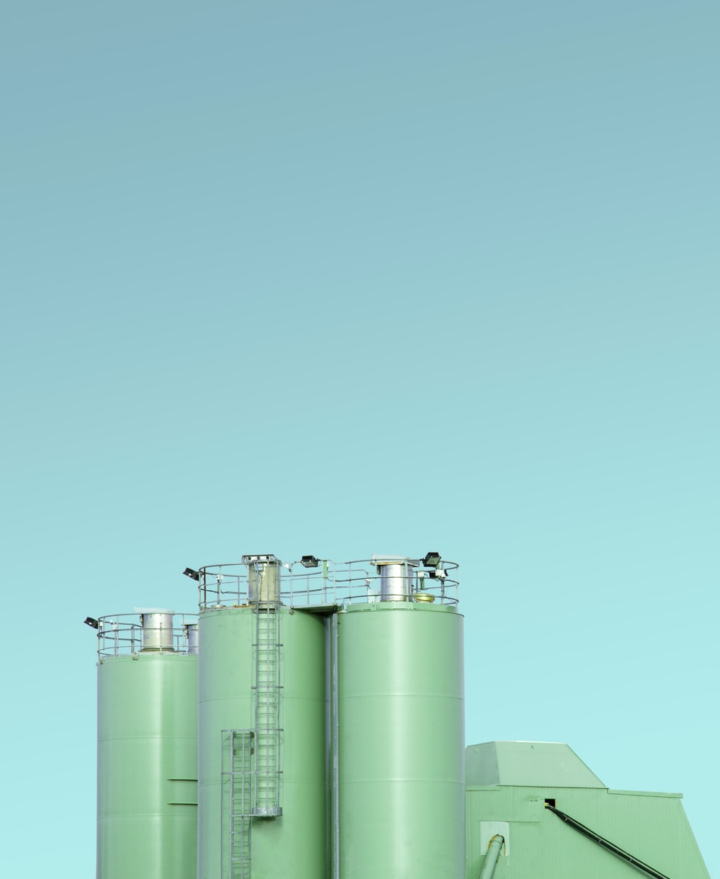
The Approach of the Pact
Upskilling to promote:
Generational renewal
Ecosystem attractiveness
Employment in rural areas
Reskilling to safeguard:
Micro, small and medium companies
Progressive technological transition
Traditional sustainable practices
Notes:
The partnership should develop the means to monitor the progress towards these goals. To this purpose, the specific Key Performance Indicators will include:
Number of stakeholders involved and coverage of the agri-food ecosystem;
Coverage of Member States and regions;
Number of participants in up-skilling actions in the remit of the partnership;
Coverage of data available to the partnership to further monitor the evolution of their commitments;
Stakeholder engagement in sectoral drivers of change, such as:
Digitalisation;
Circular and bio-based economy;
Sustainability;
Generation renewal;
Life-long learning schemes;
Institutional cooperation at national and transnational level;
Curricula development for sub-sectorial needs.

Slide 9
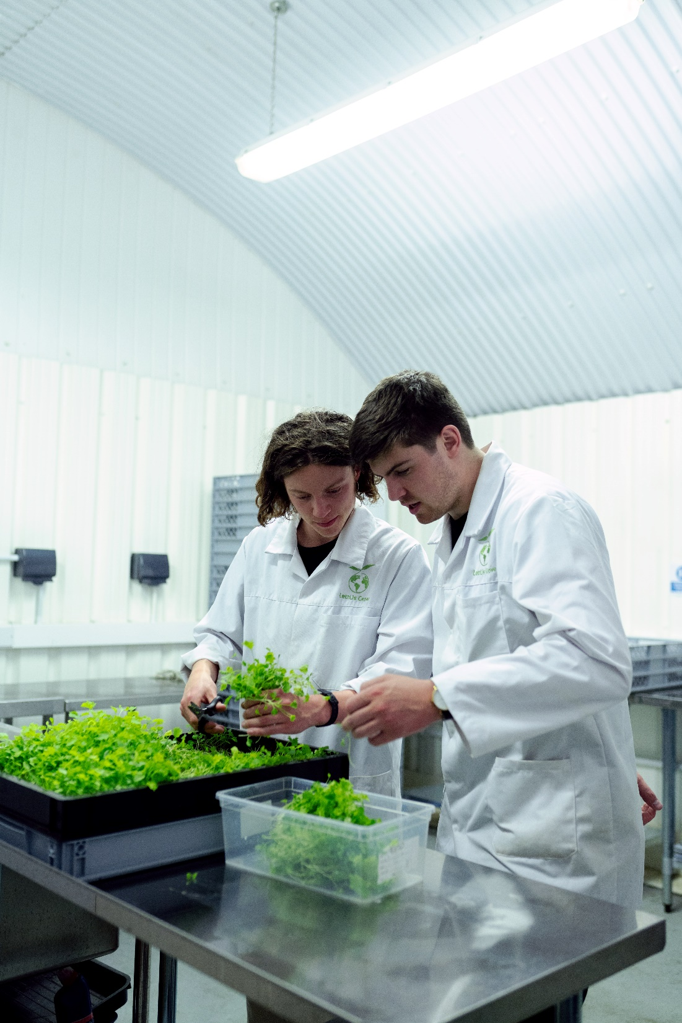
Ongoing Assessments
Copa-Cogeca & Geopa
Joint Task Force on the Pact for Skills
FoodDrinkEurope
Competitiveness Department Meetings
European Commission
DG GROW, DG EMPL, DG AGRI
Ecorys
Supporting Services
Core Group
Governance Structure
I-RESTART
EU Observatory on Agri-food Skill Needs

Slide 10
Signatories

Slide 11
Next Steps
10 Nov 2020
EC launches Pact for Skills
18 Feb 2021
Agri-Food Roundtable
18 Oct 2021
Stakeholders’ meeting
18 Feb 2022
Launch
March - April
Setting Governance
May – June Roadmap

Slide 12
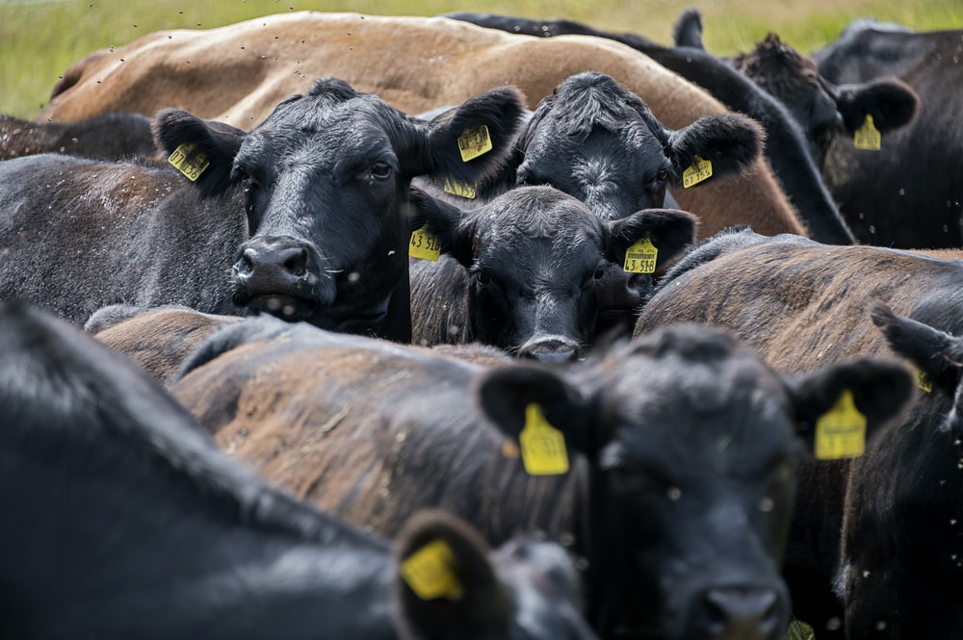
Thank you!
Manuel Delgado
Senior Policy Advisor
Employment & Social Affairs
manuel.delgado@copa-cogeca.eu

