Slide 1
Fields - Task 2.1 Skill Gaps and Occupational Profiles
Alexandre MORIN
AC3A

Slide 2
T.2.1 Info, Deliverables & Milestones
WP Start/end date: M12-M15
Partners involved: UNITO, CONFAGRI, ISEKI, ICOS, AERES, AP, UHOH, CERTH, ACTIA, GAIA, CONFAGRI PT, SCOOP, GSZ, LVA, UCLM, AC3A, FIAB, FDE, FENACORE, INFOR, LLL-P, ANIA, PlanetETP, EFB, PA, FJ-BLT, AFVET, CEPI, FJ-BLT
Target: look at future skill needs, the existing trainings in response to those needs, and identify gaps.
Main Objectives:
Assess skill gaps in the bioeconomy, sustainability, and digitalisation sectors
Create a detailed baseline of occupational profiles and skills needed in these sectors
Deliverables
D2.1: Detailed baseline of occupational profiles (M15)

Slide 3
Analysis of skill gaps and new profiles creation
Methodology
Identification of skill needs throught working groups by category (Bioeconomy, Digitalisation, Sustainability) and working sectors (Agriculture, Agri-Food, Forestry)
Creation of occupational profiles based on ESCO criteria:
Description
Alternative label
Essential skills and competences
Essential Knowledge
Optional skills and competences
Optional Knowledge
Review of the profiles and compilation in a reference & strategy document

Slide 4
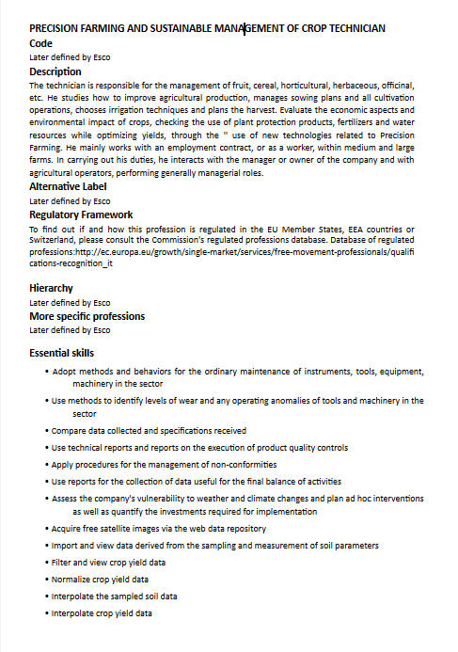
Analysis of skill gaps and new profiles creation
Get inspiration … Two profiles created so far by CONFAGRI:
PRECISION FARMING AND SUSTAINABLE MANAGEMENT OF CROP TECHNICIAN
(National Profile of reference: Agricultural Technician)
2. SOCIAL MEDIA MARKETING AND E-COMMERCE MANAGER IN THE AGRI-FOOD SECTOR

Slide 5
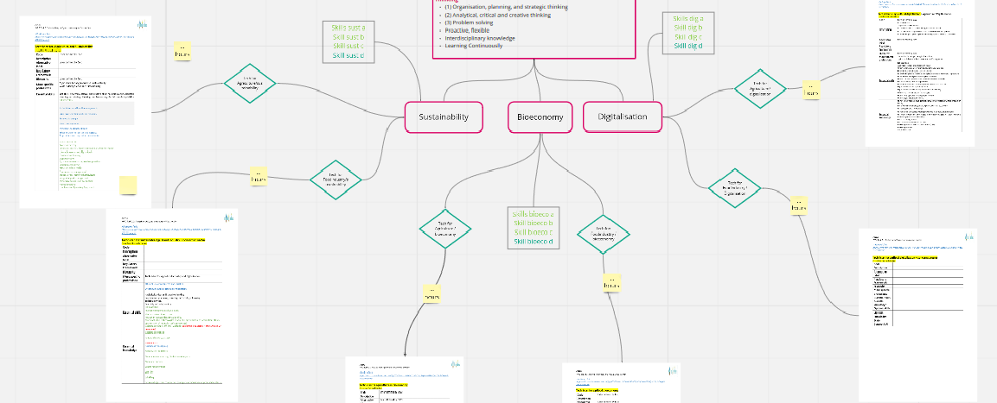
Analysis of skill gaps and new profiles creation

Slide 6
Analysis of skill gaps and new profiles creation
Creation of 10 different profiles as follow:
+ a Basic Module on Soft Skills and Entrepreneurship
Profiles reviewed and finalized
Compiled in a baseline strategy document
First version of Draft report reviewed by the partners
Bioeconomy | Digitalisation | Sustainability | Forestry
3 Agrifood OP Technician - EQF level 5 |  |  | 1 Forestry OP Technician - EQF level 5
3 Agriculture OP Technician - EQF level 5
3 transverse profiles Operator - EQF level 4

Slide 7
Analysis of skill gaps and new profiles creation
Recent steps : creation of additional EQF level 4 profiles as follow:
Addition of description in all the profiles (first on the EQF level 5, then on the EQF level 4 profiles)
Final versions are included in the Task Report including all the profiles (with description)
Bioeconomy | Digitalisation | Sustainability | Forestry
3 Agrifood OP Technician - EQF level 5 |  |  | 1 Forestry OP Technician - EQF level 5
3 Agriculture OP Technician - EQF level 5
3 transverse profiles Operator - EQF level 4

Slide 8
Thank you for your attention!
Alexandre MORIN, contact@ac3a.chambagri.fr
AC3A

