Slide 1
WP3 - New tools and training design (UNITO)
UNITO
Remigio Berruto, Patrizia Busato
4th Partner meeting - virtual
17/03/2021

Slide 2
Task 3.1: Methodology definition (UNITO)
Duration: M4-M9 – started in M7-M17
Task 3.1 objective is to define the pedagogical approach to be used in the training program to enhance farmer learning of technological and soft skills.
WP3 aims are creating relevant educational contents and curricula to answer the skill gap identified in WP1 and WP2.
The Consortium considered essential to wait for the outcomes of tasks 1.4 (Bottom-up survey), 1.5 (Future trend analysis) and in particular of 2.1 (Analysis of skill gaps and new profiles creation), part of the WP2 (Priorities and strategy design), which started and will end in M7-M12, M8-M15 and M12-M15 respectively.
This is to achieve more significant implementation of the task itself and have a broader and more in-depth view of the topic, a fundamental part of the entire project.

Slide 3
Online Learning: The evidence National Center for Academic Transformation, USA
156 courses
195 institutions
250,000 Students
Learning outcomes were improved in 72% of the courses
(ability to apply the material, retaining time, critical thinking…)
Cost of instruction was reduced on average 34%
Cost reduction for students as well…
Notes:
The advantages of online learning have been well documented when they relate to improving learning and reducing the cost of instruction. Detailed and extensive studies have been conducted related to this. One notable study is that conducted by the National Center for Academic Transformation in the USA.
In this study 250,000 students were followed in 156 courses spanning 195 higher education institutions.
It was found that on the average, student learning outcomes were improved in a very high percentage of the courses delivered. By student outcomes meaning the ability of the student to understand, apply and use the knowledge in critical thinking activities.
Furthermore, although not part of this study, other research has indicated that students prefer this form of instructions.

Slide 4
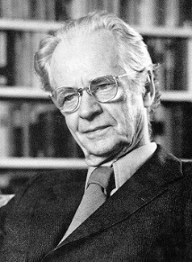
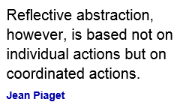
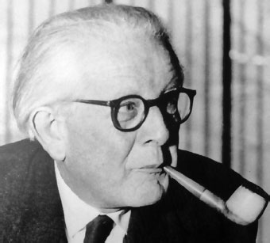
Learning Theory
Teachers must learn how to teach… they need only to be taught more effective ways of teaching
B.F. Skinner
Flipped Classroom
Behaviorism
Constructivism
1937
2000
Notes:
The basis of the flipped classroom comes from two dominant learning theories.
Behaviorism is a learning theory where the student is viewed as a “tabula rasa” that will acquire knowledge through exposure to the learning process. The role of the instructor is to “teach”. Under this theory, learning is demonstrated by the student in terms of behavior.
A second theory is Constructivism. In this learning theory, learning is considered to be a strongly social activity that involves self-reflection by the student on what the student has learned. Critical to constructivism is that in social interaction, students clarify, deepen and create new knowledge.
Note that behaviorism is teacher centered, while constructivism is student centered.
Principles of behaviorism and constructivism can be applied in the pedagogy referred to as the Flipped Classroom.

Slide 5
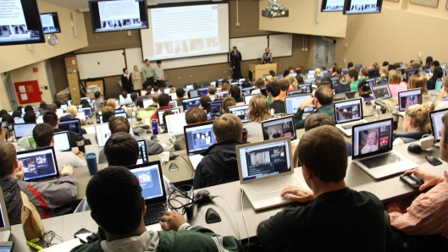
Traditional vs.Flipped Classroom
Traditional Classroom
Lecture is delivered by the instructor
Homework is assigned to reinforce understanding
Students watch lectures Online
Classroom time devoted to higher order thinking tasks
Flipped Classroom
Any TIME, Any WHERE, Any DEVICE
Notes:
So how do we take advantage of both learning theories?
For one thing it is clear that students must exhibit clearly defined behaviors that demonstrate that they have learned the material. In addition, knowing that students learn better in social contexts, create the opportunities that allow for these interactions to take place. One approach that effectively creates this context is the flipped classroom.
In a traditional classroom the primary mechanism by which knowledge is delivered to a student is a lecture. Following the lecture, students are given individual assignments in the form of homework. Regardless of some claims of “classroom interaction”, the lecture process is teacher centered and mostly one way (teacher to student).
The flipped classroom reverses this. Students, rather than attending a lecture, they view a carefully prepared video of the material and conduct some individual exercises. After this, in the time usually allocated for class, students meet for question and answers, discuss the materials learned, and work on open ended team projects.
Thus the term “flipped” refers to the time that is spent in class for a face to face lecture is now used for social learning activities. The time that was allocated to work ar home is used to watch the lectures, generally online and at the student’s convenience.
Note that the activities conducted individually do not require human interaction.

Slide 6
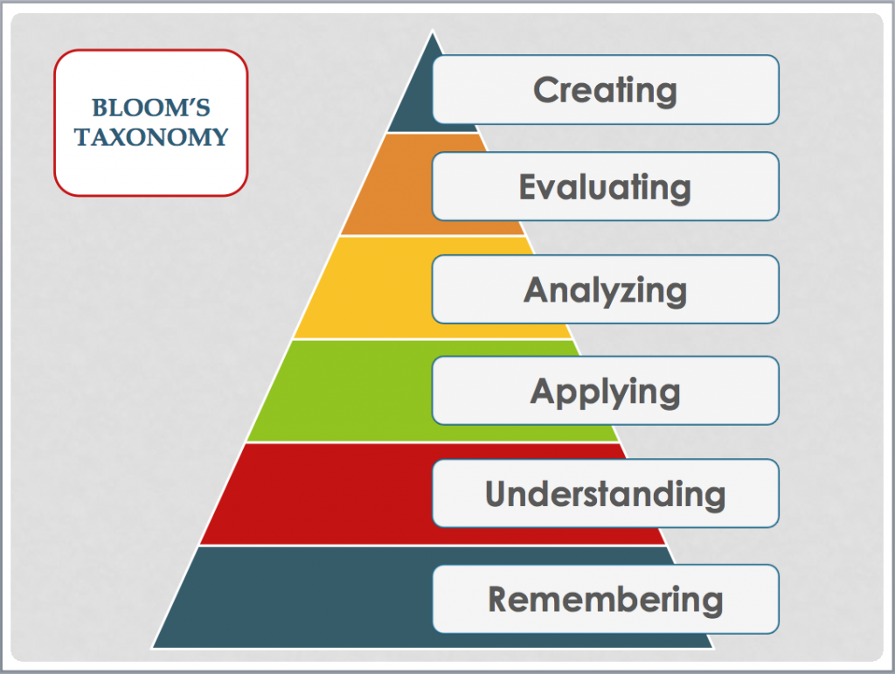
Bloom taxonomy - levels of learning
Not all materials needs higher level of learning
Not all materials needs to be taught in class
Notes:
Another important concept is Bloom’s Taxonomy.
Bloom’s Taxonomy is a useful tool to understand levels of learning when preparing educational materials.
Blooms taxonomy describes various levels of learning, starting at a shallow level and progressively increases into deeper (or higher) levels of learning.
Thus, the simplest learning conduct is associated to remembering, while the highest level of learning is when the student is able to use the knowledge to create new knowledge.
What is useful and important about this taxonomy is that it helps clarify and articulate the level at which the students are expected to perform in the learning process. This is especially useful when articulating learning objectives.
Not all arguments need to pursue high level of learning objectives, this has to be kept in mind while designing the test and the material.

Slide 7
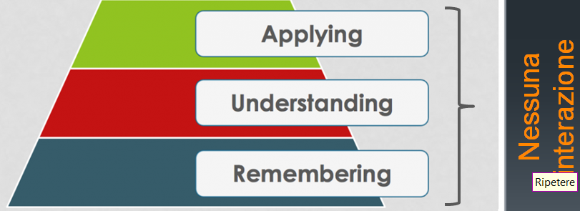
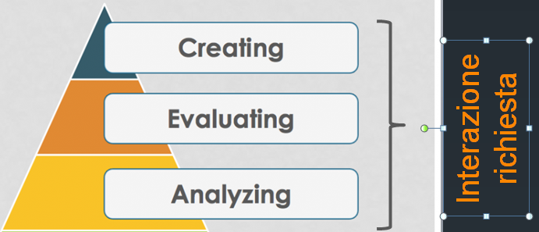
Flipped classroom activities
Activities that can be carried alone (quality of material very important)
Obtained with:
Video
Quiz, test
Exercices
Technical visits (virtual)
Activities that require interaction and collaboration
on-line, in class (collaboration and interaction important)
Techical Visits (groups)
Obtained with:
Discussion forum
Group discussion
Question/answer
Collaboration to open-ended problems
Notes:
The first three learning levels can be achieved by the student during the self-study periodo, using only videos, quizes and excercises. Some excercises could require higher levels of learning

Slide 8
Pilot Study:
UNITO Student Preferences for Conventional and Flipped Classroom Learning Environments
Goals:
Gain experience in online and flipped classroom learning methodologies
Assess UNITO students preferences for conventional or flipped classroom
Assess UNITO students performance
Notes:
To study the effectiveness of the flipped classroom, a study was conducted in collaboration between UF and UNITO to assess the performance and preferences when comparing face to face conventional learning and the flipped classroom modes of instruction.
This also created the opportunity for the faculty to learn about online learning delivery and current pedagogical techniques.

Slide 9
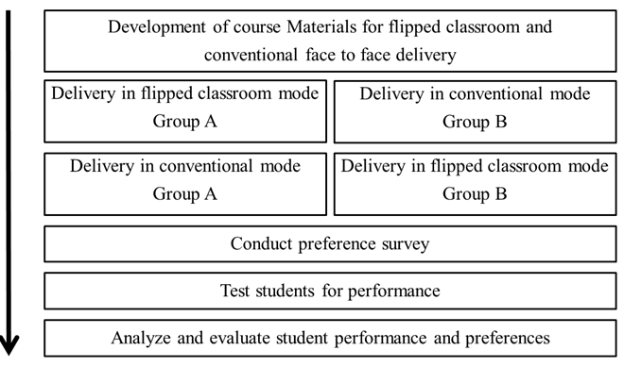
Trial design
Notes:
The trial was conducted following the steps in this diagram.
As a first step, two contiguous modules in the course were selected for this study. Then, materials were developed for both modes of instruction. Materials for both modules were developed for conventional and flipped delivery.
Then, the group of students registered in the course was randomly divided into two groups A and B.
Delivery of the first module was then done for Group A in a flipped classroom mode, while students in group B were subjected to the conventional face to face delivery.
Then, for module two, the two groups A and B were inverted. Thus, group A took module two as face to face and group B took module two as conventional face to face.
After completing the modules students were asked to take a preference survey.
The survey was followed by a test. All students took the same test at the same time.
Finally, the results were analyzed

Slide 10
Learning object ontology and activity design
Define learning objectives and how to measure them
Define tests and assessments (how we verify the Learning Objectives)
Prepare online activities (lectures, quizzes, excercises)
Prepare in class activities (open ended problems, discussion hintsetc.)
Notes:
It is very important to underline that the design, assessment and academic alignment depends on a clear articulation of what the student is to learn in terms of the student behavior.
This is done through formal statement of learning objectives. A learning objective defines the behavior, what the level of performance is and the context in which this behavior occurs.
The assessment and learning materials are developed only after a clear articulation of the learning objectives is complete.
This slide shows the ontology of a learning objective, including those activities that will carried out individually by the student and those that will require interaction with other students.
It is important to note that the design process includes in strict order: 1) define learning objectives, 2) define assessment items, 3) define learning content.

Slide 11
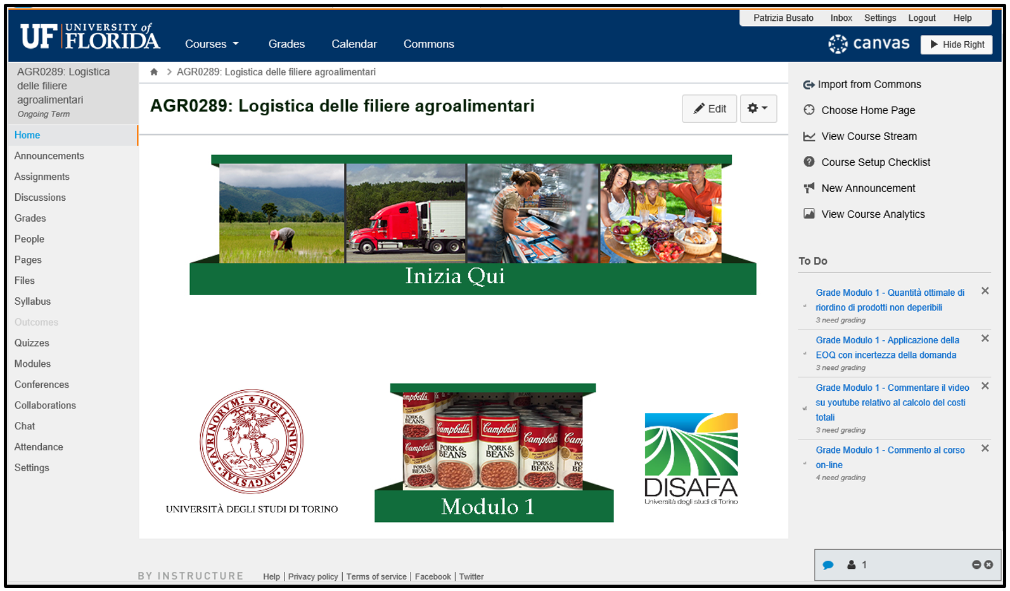
Development and deployment
Notes:
The developed course materials were implemented using the Canvas course management system. This slide shows the appearance of the first module.

Slide 12
Face to Face, in-class activity in the flipped classroom
Problems selected
Open ended problem
Closely aligned with the learning objective
Engaging
Students
Students worked in teams to devise a solution or design
Instructor provided structure and general guidance
Notes:
In this pilot special attention was paid to align the learning objectives with the problems that students worked on. This proved to be a specially difficult task, Students worked in teams to solve these problems.
During the time that the students are solving the problems the instructor plays a guiding role. Avoiding the temptation to lecture the students at this time is important. Rather than providing a solution for the students, the instructor should ask a question or make a suggestion that forces the students to reformulate their thinking.
Because its unlikely that when faced with open ended problems different groups of students will come up with the same solution, it was found that its of value to have the students present their work and receive criticism from other students.

Slide 13
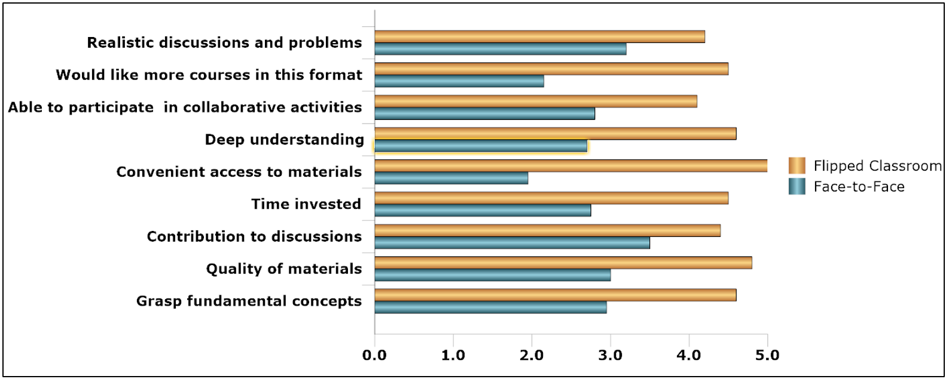
Student Preference Means
Preference for Flipped Classroom
Deeper understanding and less time invested
Convenience
Would like more
Notes:
Plotting the mean Likert responses shows the dramatic difference.

Slide 14
Student Performance
Flipped classroom scores significantly higher
Flipped classroom dispersion of scores lower
Notes:
Also, the results of the assessment (high stakes test) show that students performed consistently better in the flipped classroom format.
In the table note that the means for the flipped classroom are highlighted in blue. It can readily be seen that the performance is consistently higher for the flipped classroom. 100 vs. 78 for group A and 97 vs 62 for Group B.
Interestingly, these numbers show also that the dispersion of the grades is considerably less in the flipped classroom format. The SD for the flipped classroom in each module is 0 and 2, while for the conventional face to face is 23 and 18.
Thus this pilot appears to show that students not only prefer the flipped classroom format, but also perform better and more uniformly under that mode of instruction

Slide 15
Required instructor competency
Skills to develop online materials
Instructional design logistics
Learning objectives
Assessment items
Learning assets
Skills to develop and conduct collaborative learning
Selection of material (design problem, use case, policy, etc.)
Group management strategies (facilitate face to face and online activities)
Technical Skills
Course management system
Collaboration tools
Technical tools used by the students (simulation, GIS, web pages, etc.)
(this competence has to be developed
Through the project activities ans some of it delivered in
train the trainer modules)
Notes:
In developing a flipped classroom course it is important to note that the pedagogical approach is different. Thus it requires that the instructor learn a different way of approaching teaching.
The instructor must learn to develop online materials. This requires the instructor to work with an expert on educational technology and instructional design. It requires the instructor to learn how to develop quality learning objective, assessments and learning materials. This require formal training as the experience is different from traditional face to face. Furthermore, it requires a team of people in which the instructor is a subject matter expert.
Also, the instructor must be well versed in developing and conducting collaborative learning. Careful selection of the materials with soft but effective management strategies are essential.
Finally, the instructor must acquire some minimal level of technical skills.

Slide 16
Agrifood LogisticTraditional A.A. 2015-2016
6 modules (2 Weeks each) – 84 hours of in-class lesson
In class activity 100% of lessons
Little interaction with students → they don’t know the material
Lesson
Lesson
Lesson
Lesson
W1, Monday
W2, Monday
W3, Monday
Notes:
In the traditional class, the in-class activity is the 100% of lessons. With this method, there is little interaction with students because they don’t know the material before lesson starts.

Slide 17
Agrifood Logistic Flipped class A.A. 2016-2017
6 modules (2 Weeks each)
21 in-class activity hours
Deadline for homeworks
Quiz
Test module 1 (online)
Module 1 material available online
W1, Monday
W2, Monday
W3, Monday
Friday, W2 in-class activity
In class 25% of traditional class
High interaction during in-class activity and through the forum
Notes:
In the flipped class, the in-class activity is the 25% of traditional class. With this method, there is high interaction during in-class activity and through the use of the forum.

Slide 18
Test results comparison
Flipped class 2016-2017 (n=56)
Traditional class 2015-2016 (n=33)
Lesson attendance (>75%) 19 (57%)
Working students 2 (6.6%)
Average 26.6/30, CV 9.6%
Average workers (2) 24/30
First exam 16 (49%)
Second exam 10 (30%)
Third exam 3 (9%)
Following exams 4 (12%)
Exam with 6 open questions
Lesson attendance (>75%) 52 (93%)
Working students 4 (7%)
Average 28.2/30, CV 5.7%
Average workers (3) 27.6/30
Pre-exam 54 (96%)
First exam → all the remaining students
Exam with 57 questions, 7 open questions

Slide 19
Result consideration
Flipped Exam test more deep knowledge (57 questions vs. 6)
FC High average score →28.2 vs. 26.6 (+1.6/30) → better preparation
FC High score working students → 27.6 vs. 24 (+3.6/30) → less difference with normal students→ quality of online materials
FC CV low → 5.7 vs. 9.6 → more opportunities for students with difficulties to learn
FC High results on first attemp→96% vs. 57% → gradual preparation of students (6 tests during course teaching) that do not require to study for final exam
Notes:
Flipped Exam test more deep knowledge (57 questions vs. 6)
High average score was 28.2 versus 26.6 (+1.6/30), the flipped classrom student had better preparation
High score working students was 27.6 versus 24 (+3.6/30), less difference with normal students because of better quality of online materials
CV low → 5.7 vs. 9.6 → more opportunities for students with difficulties to learn
High results on first attemp → 96% vs. 57% → gradual preparation of students (6 tests during course teaching) that do not require to study for final exam

Slide 20
Reasons to adopt the flipped class
Language and technology familiar with students today
Students could look again at the lesson
Increase interaction student-teacher
Allows teachers to know better their students (continuous monitoring of student activities)
Increase interaction with students
Change management of in class time
Add flexibility in time management for students
Add flexibility in time management for teachers
High ranking education institutions use it
Notes:
Language and technology are familiar with today’s students. Students could look again at the lesson, there is an increase in the interaction student-teacher that allows teachers to know better their students and also increase interaction within students.
Change management of in class time, add flexibility in time management for students and for teachers.
High ranking education institutions use it and it simplify the offer of classes in english.

Slide 21
Benefits
Student convenience
Higher levels of achievement
Availability of learning materials anytime, anywhere, on any device
High levels of student-student and student-instructor interaction
Create a skilled workforce
Reduce costs (e.g. Travel expenses)
Resilience of teaching system during pandemic
High ROI
Better use of classroom space
Flexibility for instructors
Notes:
However, this effort is well spent as there are several benefits to this mode of instruction that result in better learning and reduced costs of instruction.

Slide 22
Example of Learning Objectives (From PLANET)
Module 0 | PLANET Introduction, Gender equality and safety training course
Day1 | Introduction to the Planet Course
LO1 | Know the educational tools, the training rooms, and the trainers.
LO2 | Understand the structure of the course.
LO3 | Be aware of personal competence (Core, technical and soft skills).
Day2 | Renewable energy: Environmental sustainability and market potential
LO1 | Be aware of the general issue on environmental sustainability
LO2 | Know the impact of the RES on environmental protection
Day 3 | Horizontal principles and occupational safety and health
LO1 | Understand the concept of equal opportunities and gender equality and how to create a positive work environment.
LO2 | Understand the general education on occupational safety and health.

Slide 23
Thank you for your attention!
Remigio Berruto, UNITO
Remigio.berruto@unito.it

