Slide 1
FIELDS WP4 – Task 4.3 Map creation updated and use
Francesca Sanna, Project Manager
Francesca.sanna@unito.it
5th Project Monitoring Meeting
30-31 May 2022

Slide 2
WP4 – Implementation (AERES)
Task 4.3: Map creation, update and use (UNITO), M4-M48
Francesca Sanna (UNITO)
D4.3: Online public platform and map (M12)
In order to make the project outputs visible, usable and easily accessible during and after the project, a database with a geographical map, created to collect resources in T1.1 were upgraded and made publicly accessible by UNITO.
It will be kept updated during the project lifetime and maintained afterwards.

Slide 3
Task 4.3: Map creation, update and use
Database with a geographical map
All information created in the project, in particular:
Organisation (WP1)
VET providers/stakeholders (WP1)
Previous best practices, projects and their outputs (WP1)
Curricula available within the project and outside (WP1)
Stakeholders interested in the training and offering apprenticeship (WP3)
National and EU frameworks and funding opportunities (WP5)
Management portal
http://www.erasmus-fields.eu/management/?q=node/871
Notes:
The databases will be further used in Task 4.3 and integrated with a geographical map as an additional layer on the website.

Slide 4
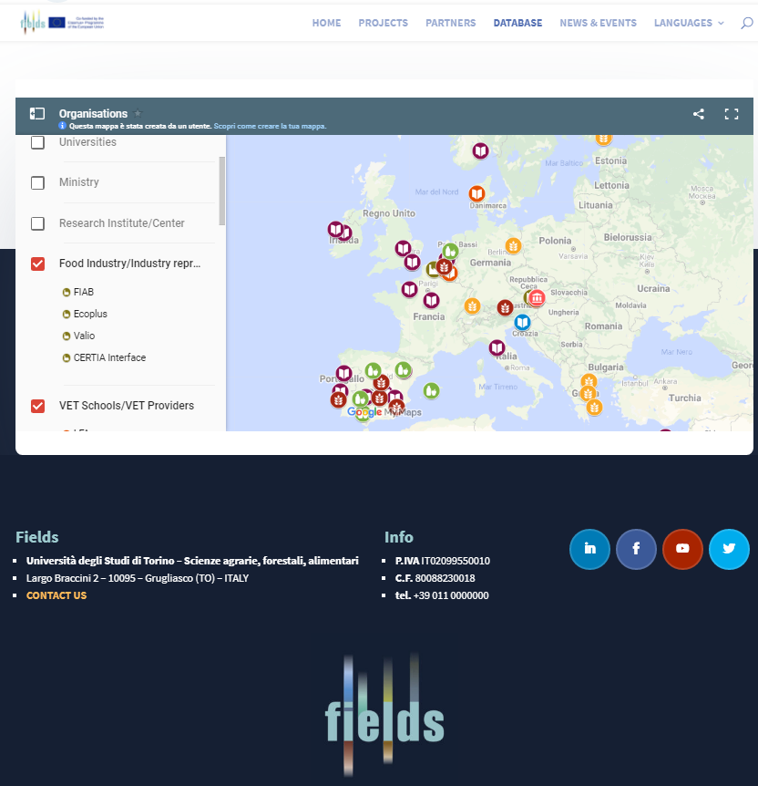
https://www.erasmus-fields.eu/database/
Public website
- Home page
- Database

Slide 5
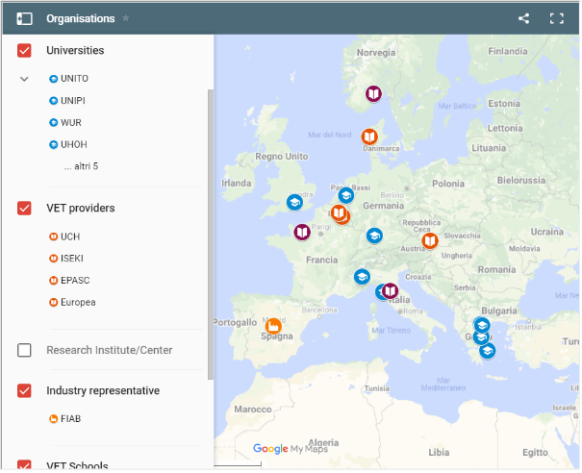
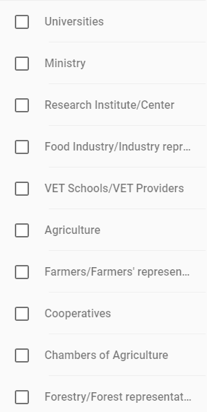
Task 4.3: Map creation, update and use
About 120 records inserted so far!
http://www.erasmus-fields.eu/management/?q=node/871
It will be kept updated during the project lifetime and maintained afterwards.
Notes:
The databases will be further used in Task 4.3 and integrated with a geographical map as an additional layer on the website.

Slide 6
Thank you for your attention!
Francesca Sanna, FIELDS project manager
francesca.sanna@unito.it

