Slide 1
Task 6.4- EQAVET assessment (INFOR) M27-M48 (ICOS, AERES, AP, UCLM, AC3A, PA, EFVET)
Giuseppe Vanella
Paris, May the 31st, 2022

Slide 2
The Legal basis for VET course certification
Article 165(1) of TFEU lays down that the Union is to ‘contribute to the development of quality education by encouraging cooperation between Member States and, if necessary, by supporting and supplementing their action, while fully respecting the responsibility of the Member States for the content of teaching and the organisation of their education systems’.
Article. 165(2) of TFEU further specifies that Union action in education will be aimed, in part, ‘at encouraging mobility of students and teachers, by encouraging inter alia, the academic recognition of diplomas and periods of study’.
Article 166(1) of TFEU says that the Union is to ‘implement a vocational training policy which shall support and supplement the action of the Member States, while fully respecting the responsibility of the Member States for the content and organisation of vocational training’.

Slide 3
EQAVET and ECVET
The Council Recommendation of 24 November 2020 on Vocational Education and Training (VET) for sustainable competitiveness, social fairness and resilience 2020/C417/01 replaces the Recommendation of the European Parliament and of the Council of 18 June 2009 on the establishment of a European Quality Assurance Reference Framework for Vocational Education and Training (EQAVET), and the Recommendation of the European Parliament and of the Council of 18 June 2009 on the establishment of a European Credit System for Vocational Education and Training (ECVET).
Reinforcement - EQAVET supports the implementation of the 2020 recommendation on vocational education and training for sustainable competitiveness, social fairness, and resilience. The VET Recommendation describes how EQAVET can be used to strengthen the quality of initial and continuing VET and presents the complete EQAVET framework.
Repeled - ECVET: Ongoing revision with the Proposal for a Council Recommendation on a European approach to micro-credentials for lifelong and employability (2021/0402 NLE) intended to support building trust in micro-credentials across Europe by 2025.

Slide 4
The EQAVET Framework
EQAVET is based on a quality assurance and improvement cycle (planning, implementation, evaluation/ assessment, and review/revision) and a selection of descriptors and indicators applicable to quality management at both VET-system and VET-provider levels.
EQAVET does not prescribe a particular quality assurance system or approach, but provides a framework of common principles, indicative descriptors and indicators that may help in assessing and improving the quality of existing VET systems and VET provision. EQAVET can therefore be regarded as a ‘toolbox,’ from which the various users may choose those descriptors and indicators that they consider most relevant to the requirements of their quality assurance system.

Slide 5
EQAVET Framework
The European Quality Assurance Reference Framework is used in national quality assurance systems,…is underpinned by a set of indicative descriptors and common reference indicators for quality assurance in vocational education and training applied both at system and provider level, according to national context.
For quality assurance of the delivery training content we adopt here some of these indicators:
Indicator n.3. Participation rate (Number of participants in VET Programmes)
Indicator n. 4. Completion rate (Number of persons having successfully completed VET Programmes)
Indicator n. 5. Placement rate (Destination of VET learners at a designated point in time after competition of training)
Indicator n. 6. Satisfaction rate (Utilisation of acquired skills at the workplace)
Indicator n. 9. Material quality
A dedicated Quality Assessment Form will be developed using the format already used for certified learning course.

Slide 6
The certification in Italy
INFOR ELEA is accredited with the Piedmont Region as a training institution eligible to organize and deliver education, vocational training and guidance services, since the Competent Body has verified the possessing of structural, organizational and economic-financial requirements imposed to guarantee the reliability of the Entity in charge of delivering quality services while safeguarding the effectiveness and efficiency of internal processes.
Competent Body: Regione Piemonte
Accredited VET provider: INFOR ELEA
INFOR ELEA is Awarding Body for validation
of non-formal and informal learning

Slide 7
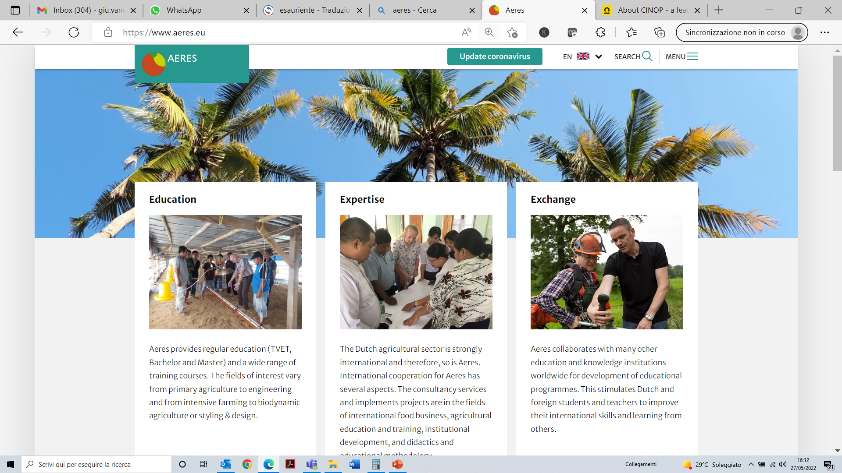
The certification in The Netherlands
The quality of education in the Netherlands is guaranteed in two ways.
Firstly, through the Education Inspectorate. This government organisation periodically (usually once every 4 years) inspects all government-funded educational institutions. If the inspection shows that the education provided by the institution in question does not meet the quality requirements, the institution comes under supervision and is instructed to improve on the shortcomings identified. Our courses could be included in a full training programme, making the course part of the curriculum and thus subject to quality assessment by the Education Inspectorate.
The course certification goes through an organisation called CINOP. It is actually not a certification but a grading according to the NLQF and therefore also the EQF scale.

Slide 8
Thank you for your attention!
Giuseppe Vanella, giuseppe.vanella@inforelea.academy
INFOR ELEA

